Slide 1
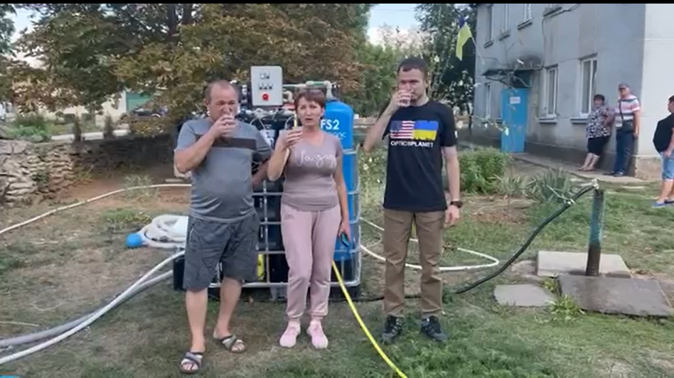



Making a difference to support Kherson

Slide 2
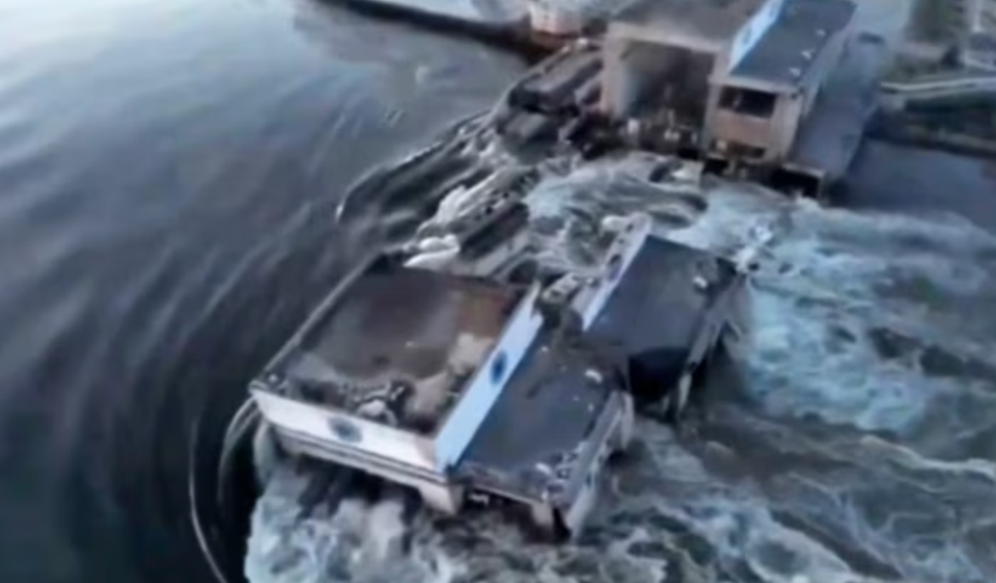
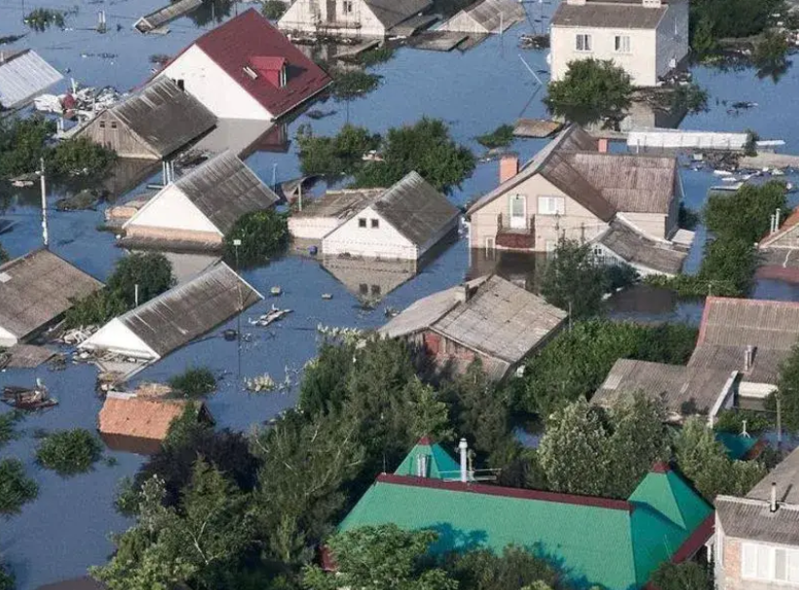
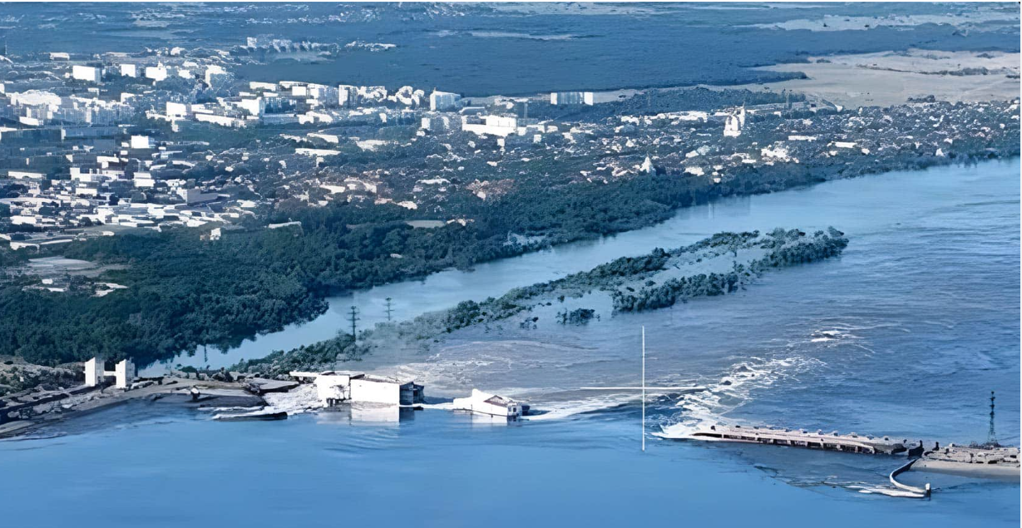
BACKGROUND
At 2:50 a.m. on June 6th 2023, a disaster occurred that was long warned about and feared. Russian troops blew up the Kakhovka dam, a hydro-electric power station that supplies southern Ukraine with electricity and fresh water. This station is also important for the operation of the Zaporizhzhya Nuclear Power Station, the largest in Europe.
The capacity of its cooling ponds depends on the water level in the reservoir above the dam. In the first hours after the detonation, the reservoir drained rapidly and water completely or partially flooded eight settlements and one city district of Kherson. About 16,000 people on the Ukrainian-controlled western bank of the Kherson region fell into the critical flooding zone and many have been left without clean drinking water.

Slide 3
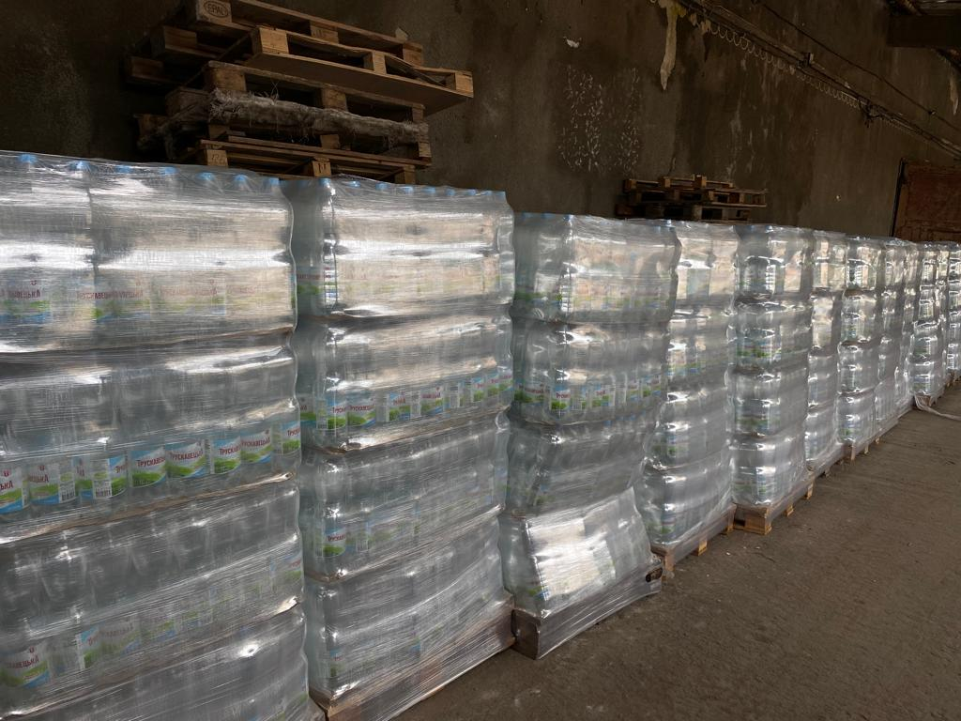
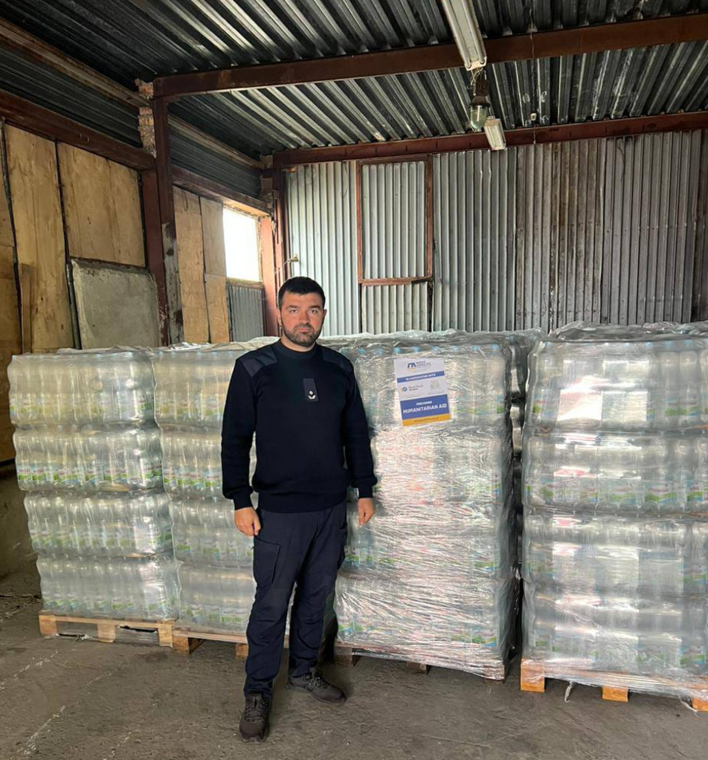
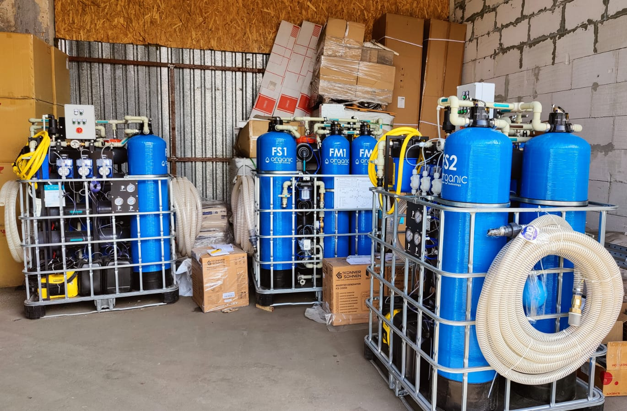
MOVEUKRAINE RESPONDED INSTANTLY
Thanks to the generosity of BlueCheck we swiftly purchased and delivered two trucks containing 14,000 1.5 litre bottles of pure water each to those in need in Kherson region. We also saw there would be a long term ongoing need for water so we ordered the manufacture of four water purification systems. These systems allow hundreds of affected people to have access to clean safe drinking water on a daily basis.

Slide 4
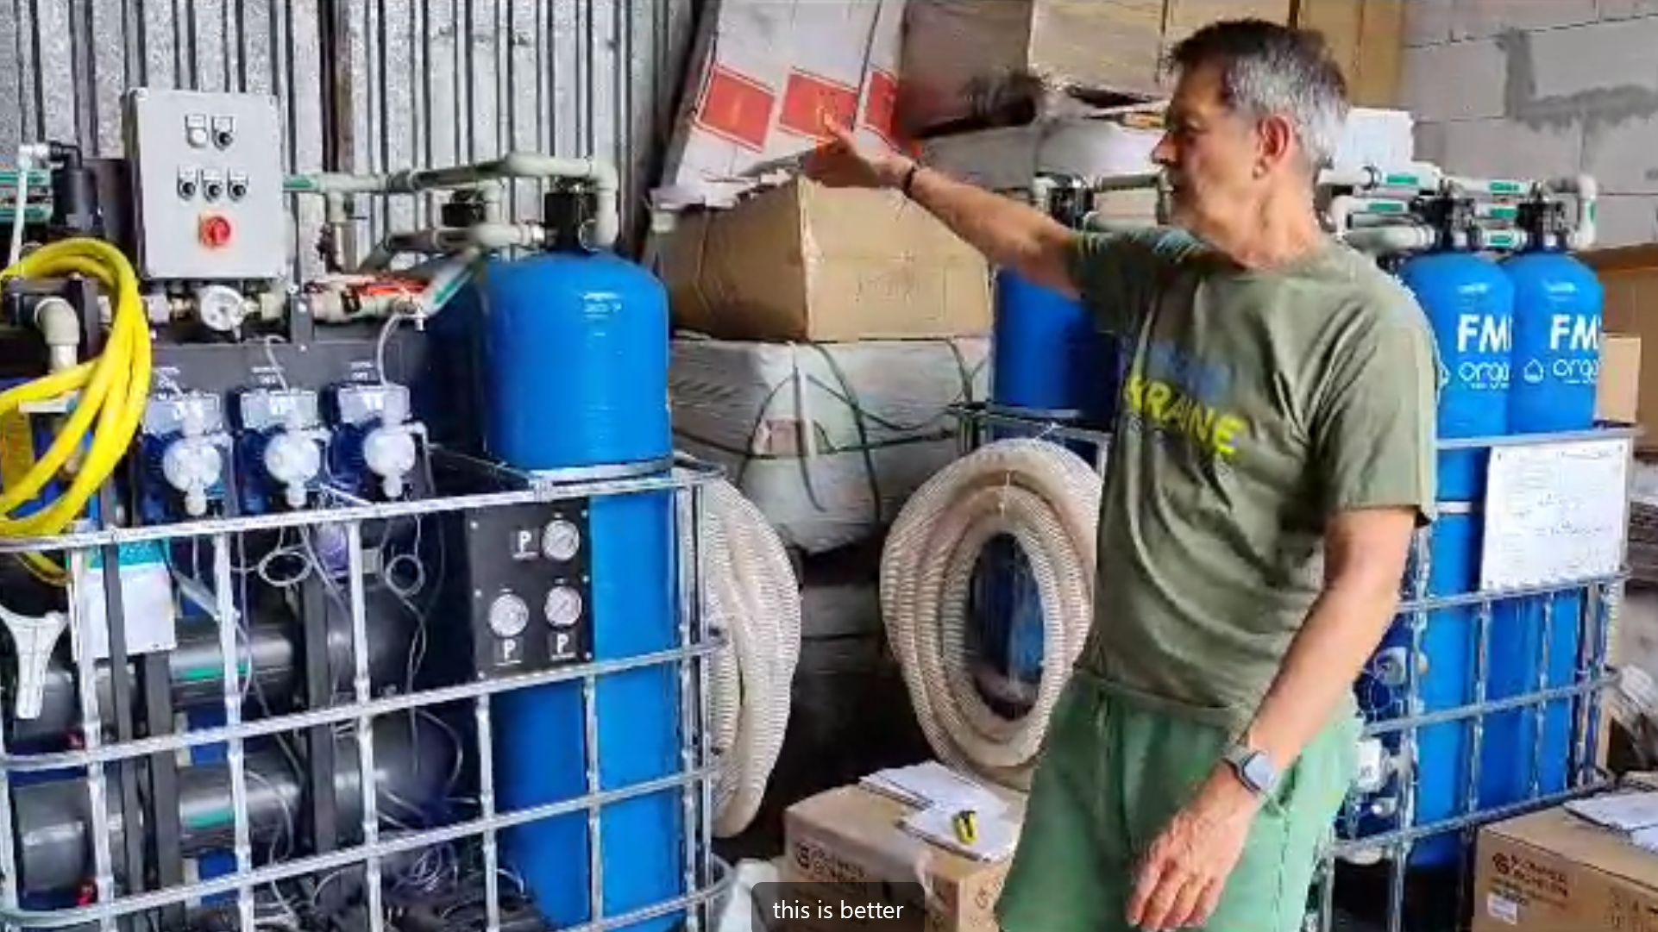
MOVEUKRAINE THANKS TO THE “BLUECHECK” FOR QUICK RESPONSE
We purchased 4 installations for the treatment of surface and artesian waters “Water Treatment Plant Organic MWTP 1000” made by “Difrano”, LLC with a capacity of up to 1.3 m3/hour (up to 30 m3/day):
#1 Placed in Lymanets
#2 Placed in Nikopol
#3 Waiting for delivery within 2 weeks
#4 Waiting for delivery within 2 weeks

Slide 5
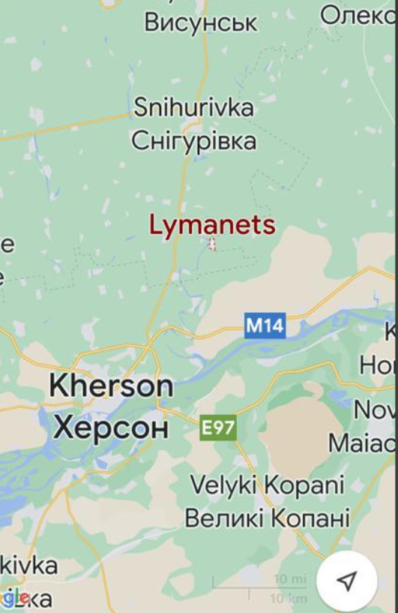
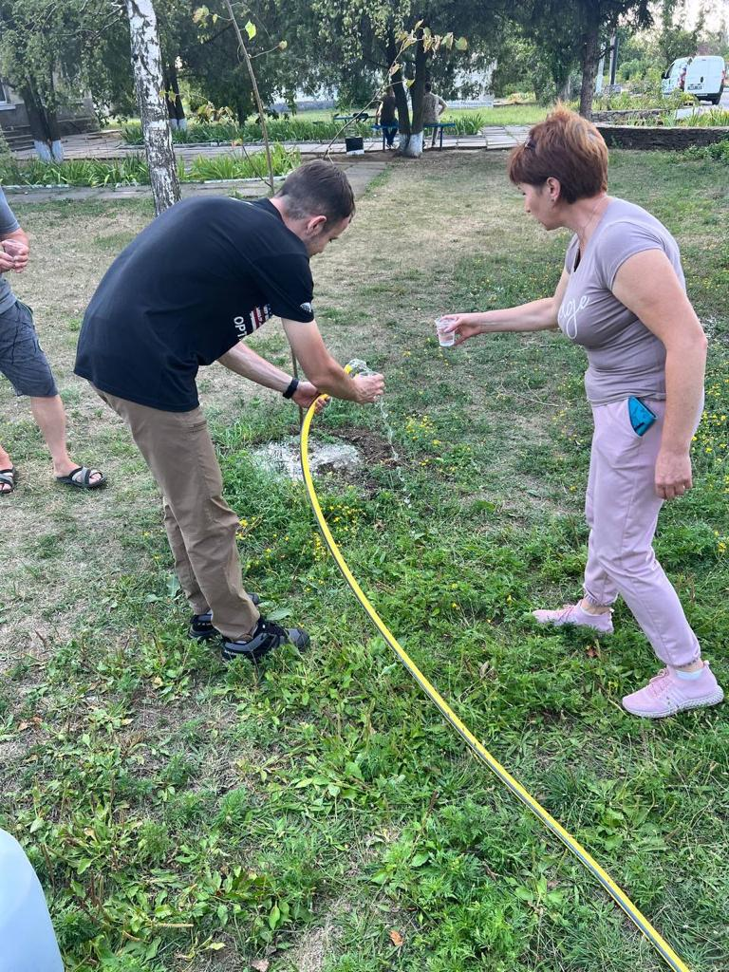
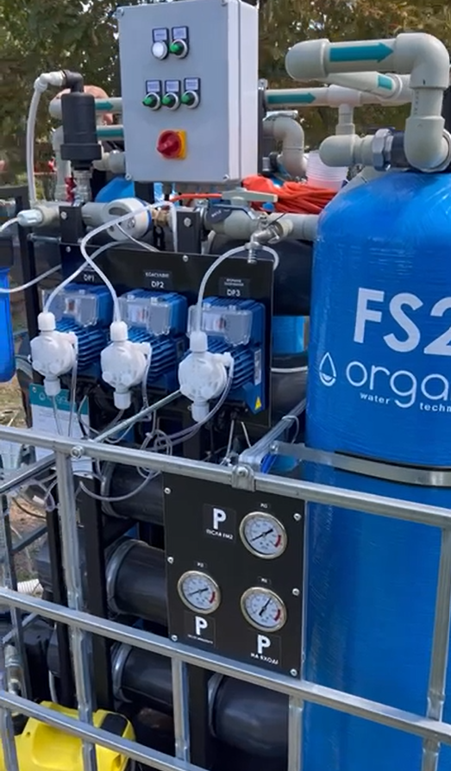
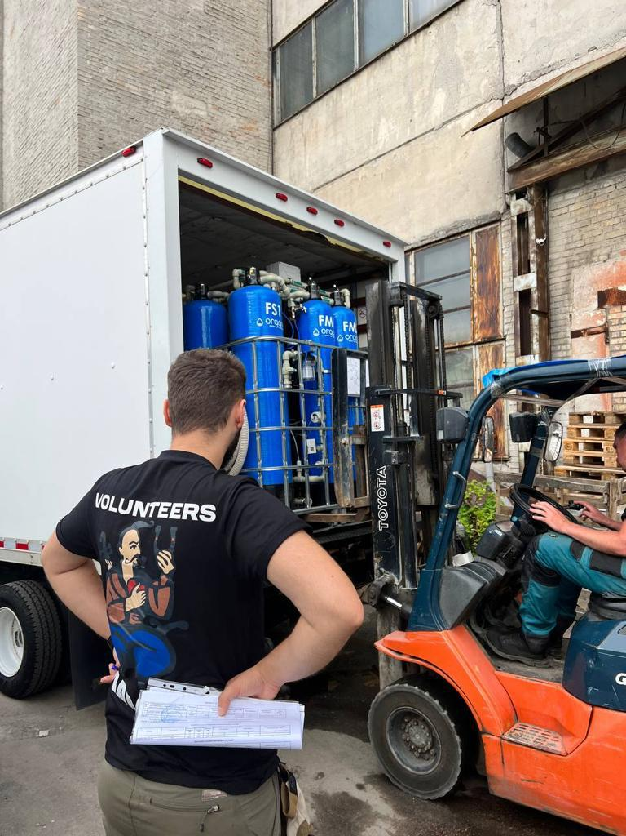

#1 - LYMANETS VILLAGE, KHERSON REGION - DELIVERED AND INSTALLED

Slide 6
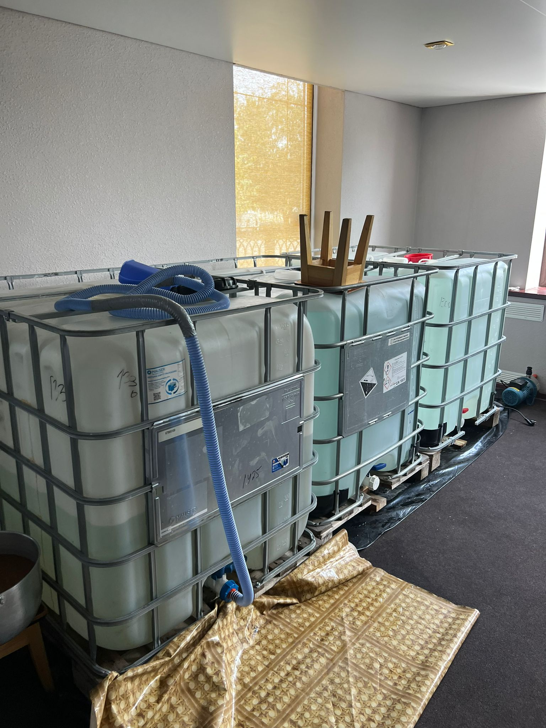
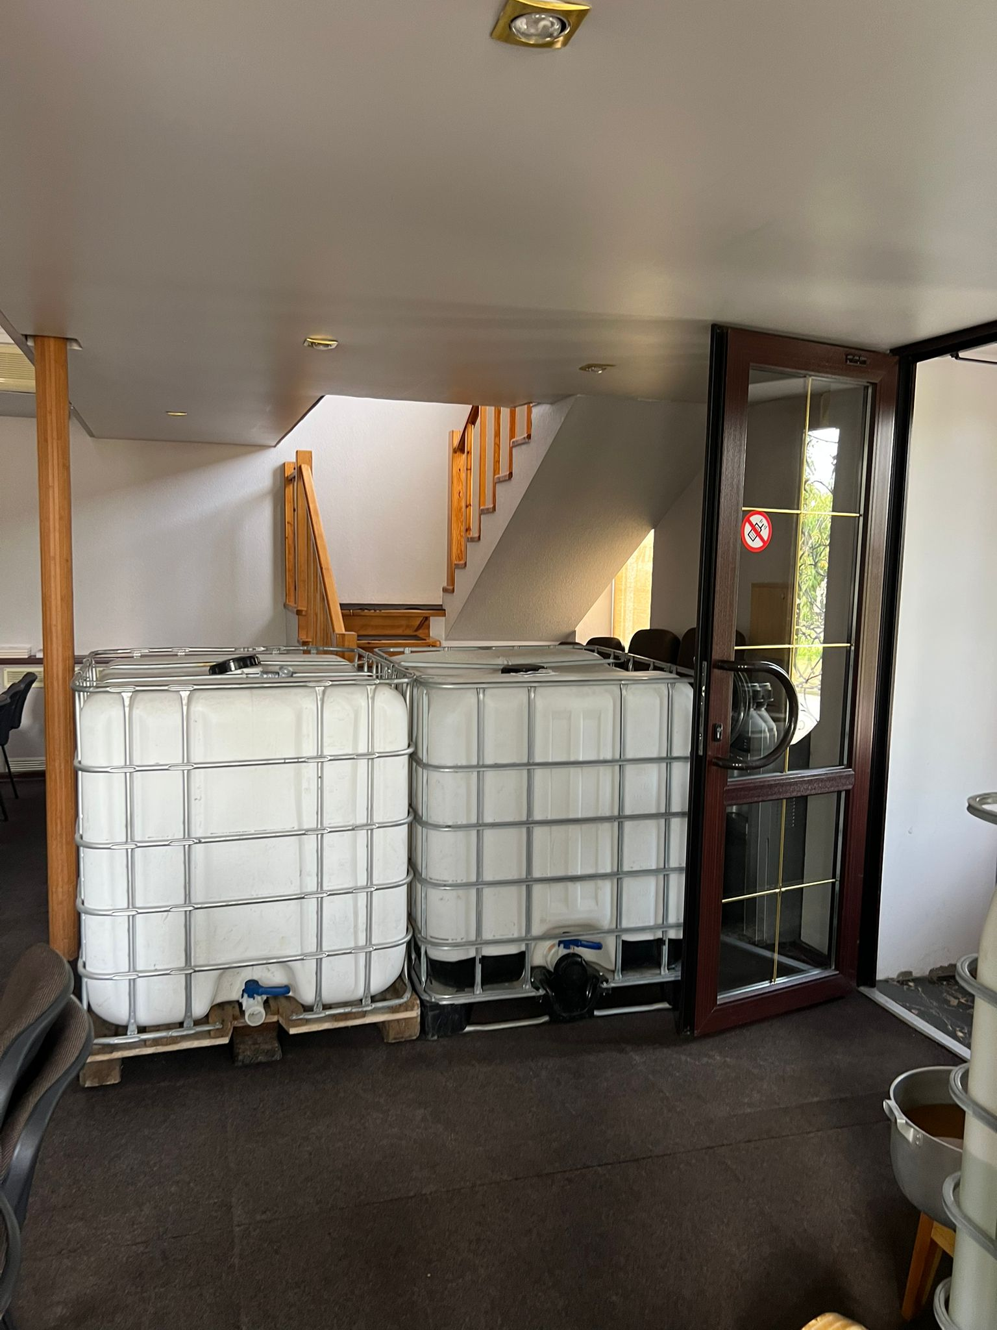
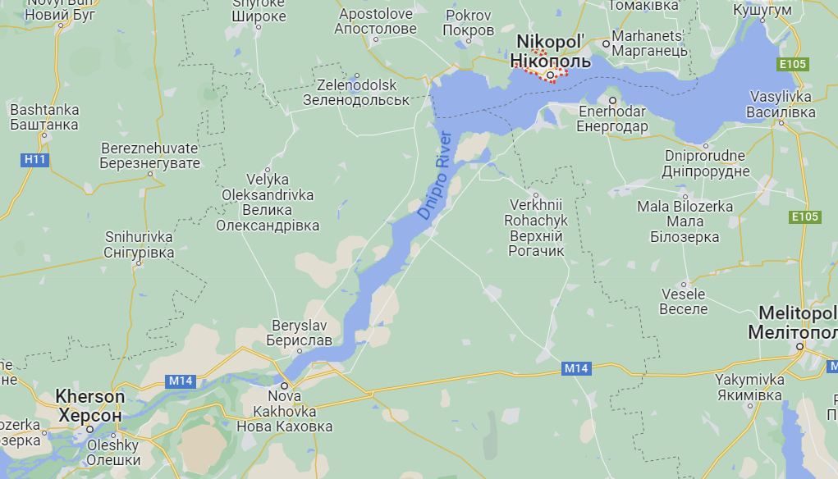

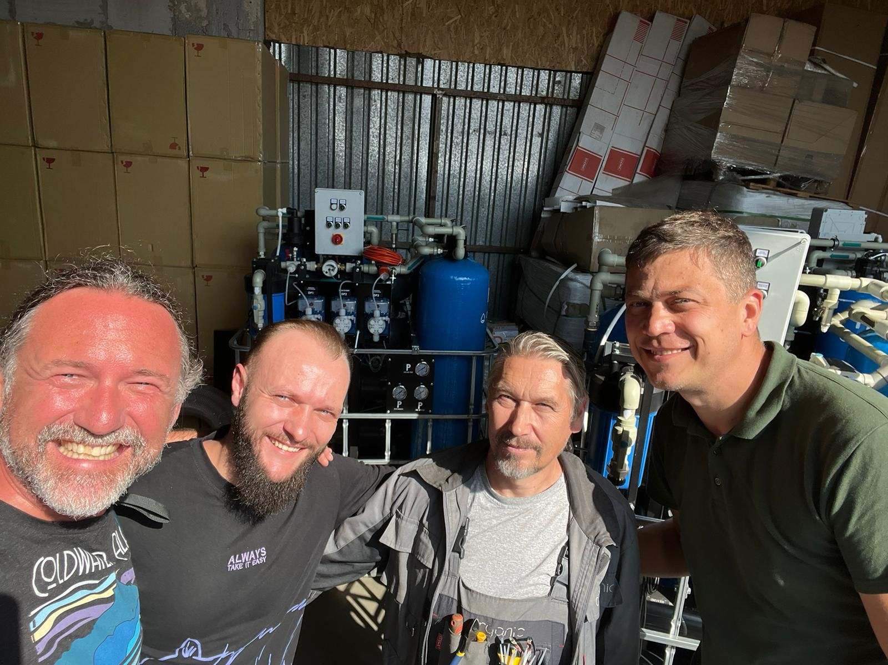


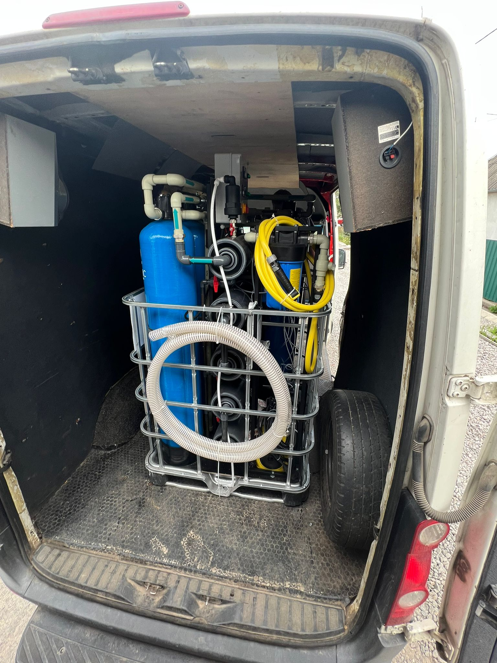
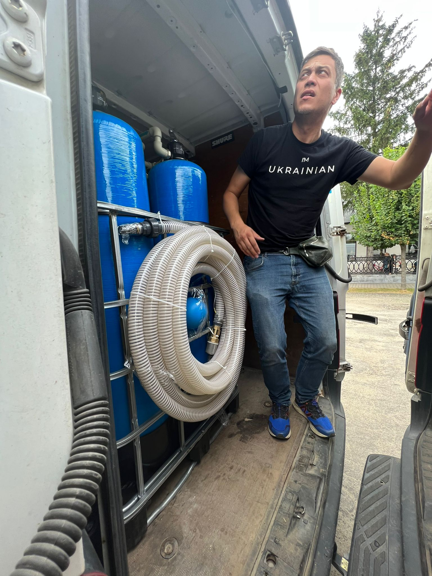
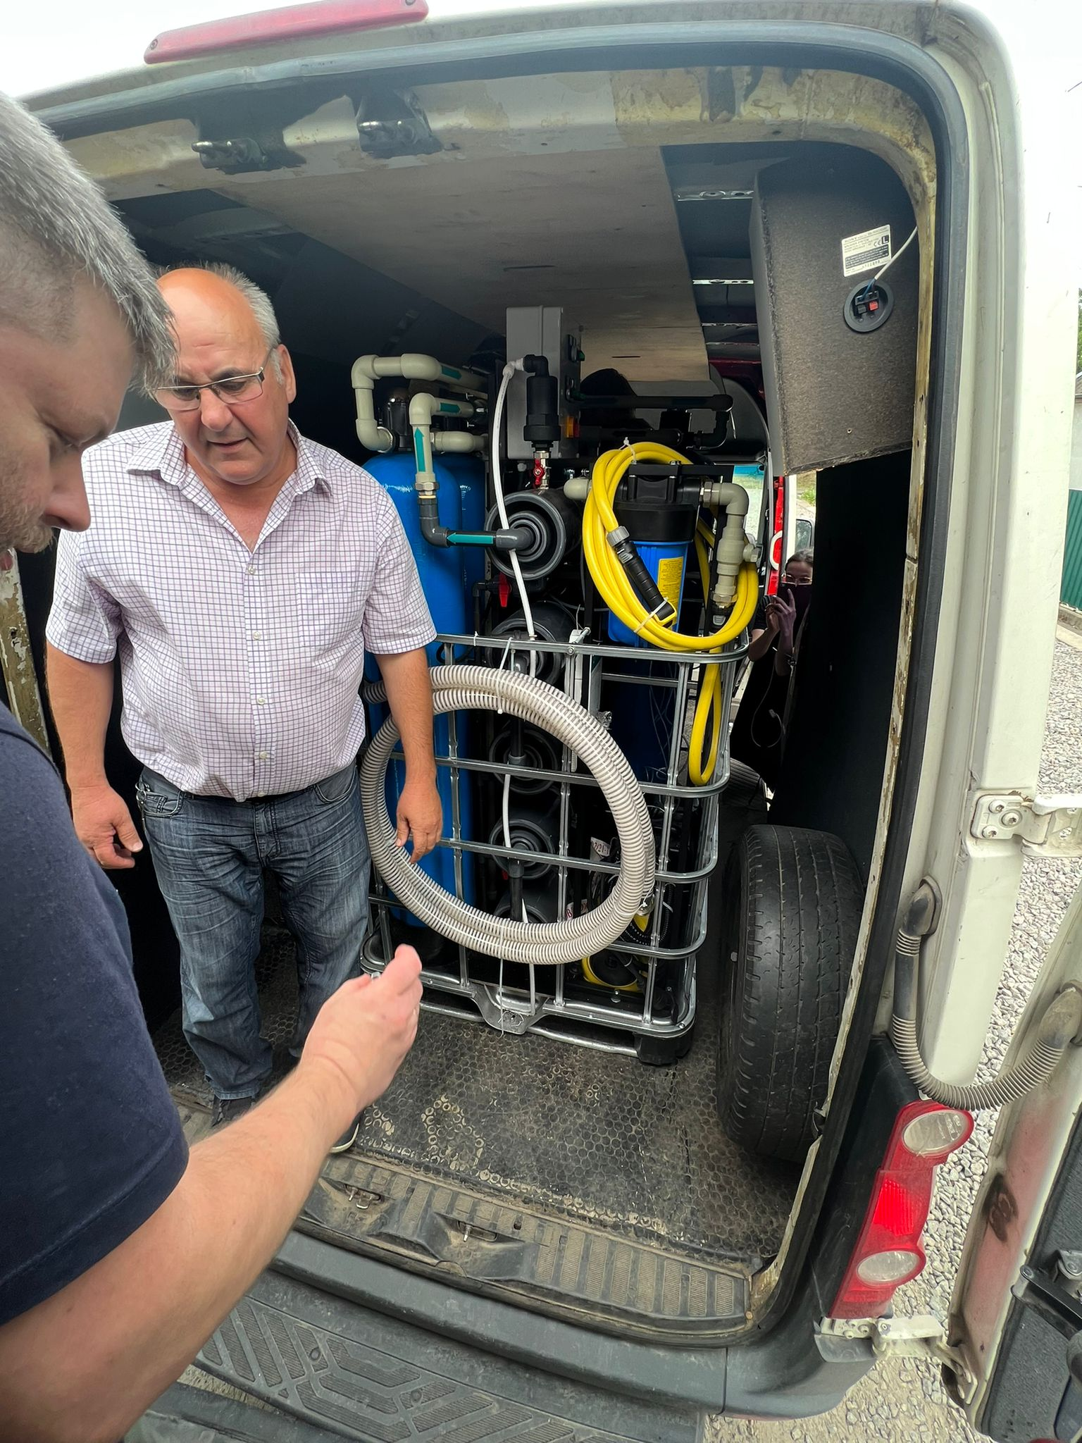
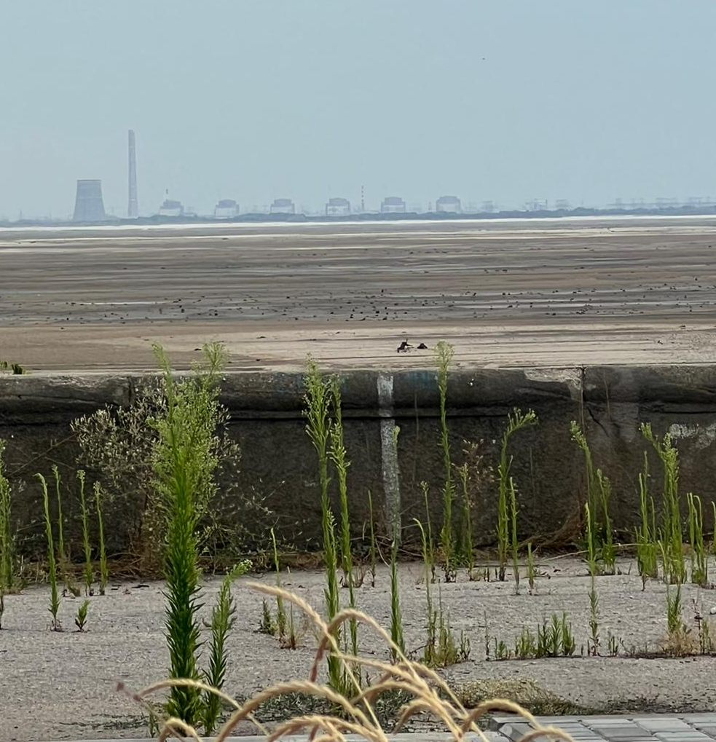
#2 - CHURCH IN NIKOPOL, DNIPROPETROVSK REGION - DELIVERED AND INSTALLED
Zaporizhzhia Nuclear Power Station
Lymanets
Kakhovka dam
View of the russian occupied Zaporizhzhia Nuclear Power Station from the Nikopol.

Slide 7
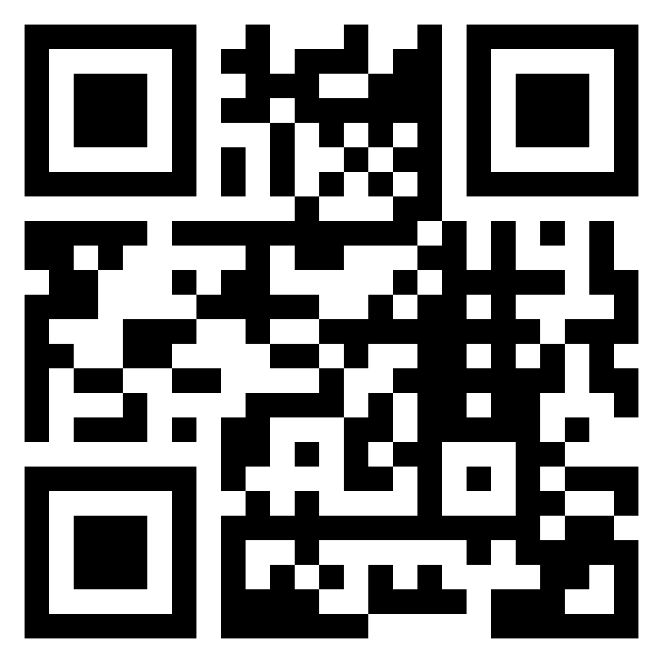
WE ARE MOVING FORWARD! MORE TO COME!
THANK YOU BLUECHECK FOR SUPPORTING UKRAINIAN FAMILIES IN NEED OF WATER !
Your donation has made a true difference!

